Slide 1
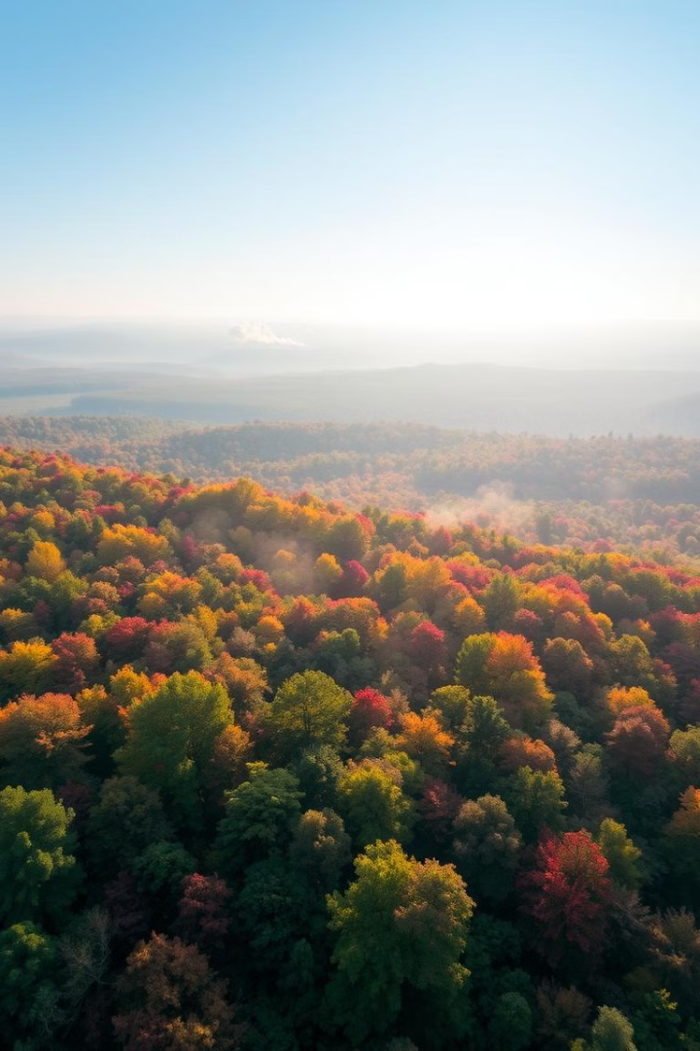

Forest Fire Detection AI: Deep Learning Solutions
Revolutionizing environmental protection with innovative AI.
by Yashwanth 18

Slide 2
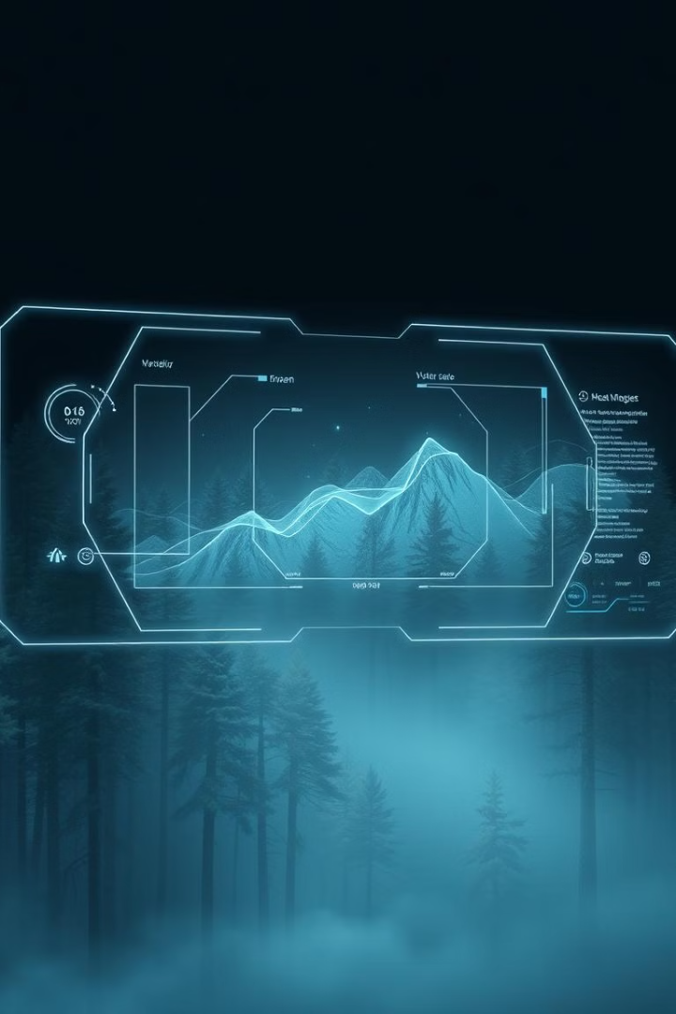
Introduction: AI for Forest Protection
1
Critical Need
2
AI Solution
Early detection of forest fires to minimize damage.
Leveraging deep learning for rapid and accurate fire detection.
3
Presentation Focus
Exploring AI's capabilities, benefits, and applications.

Slide 3




Technology Stack: CNN & TensorFlow
CNN
TensorFlow
Streamlit
Convolutional Neural Networks for image analysis.
Google's open-source framework for AI development.
Web framework for interactive application deployment.

Slide 4
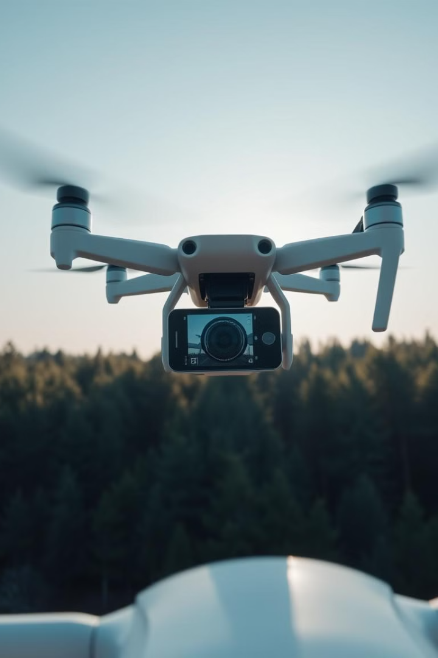



How It Works: Image Recognition
Image Input
Capturing real-time images and videos.
CNN Analysis
Analyzing images for smoke and fire patterns.
Alert System
Immediate alerts upon fire detection.

Slide 5




Use Case: Wildfire Management
Early Detection
1
Rapid Response
2
4
Damage Control
3
Resource Allocation

Slide 6
Advantage: Speed & Accuracy
Real-Time Analysis
High Precision
Wide Coverage
Immediate detection for faster response times.
Minimizing false positives and false negatives.
Monitoring large areas with fewer resources.

Slide 7
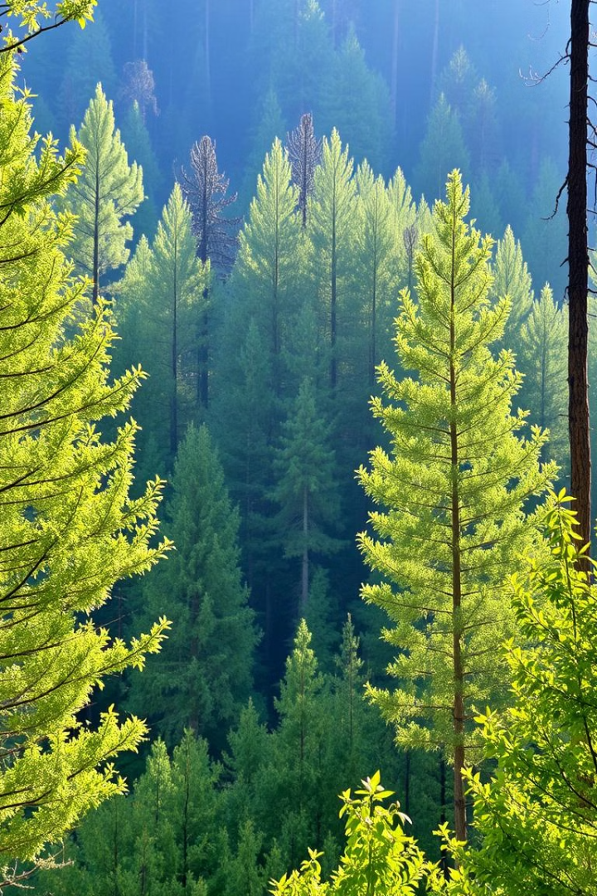
Benefit: Environmental Protection
Reduced Damage
Wildlife Safety
Preventing widespread forest devastation.
Protecting animal habitats and biodiversity.
Air Quality
Reducing smoke and pollution from fires.

Slide 8

Financial Impact: Cost Efficiency
40%
15%
Faster Response
Lower cost
Quicker response to the fires.
Reducing cost of fire prevention.
20%
Improved Accuracy
Improving accuracy in wildfire analysis.

Slide 9



Conclusion: The Future of Forest Protection
1
Enhanced Security
2
Efficiency
3
Scalability
AI represents a transformative solution for proactive forest fire management, ensuring a safer and more sustainable environment for future generations.

